Slide 1
Capstone Project – 4
Online Retail Customer Segmentation pradyumna vikram singh

Slide 2
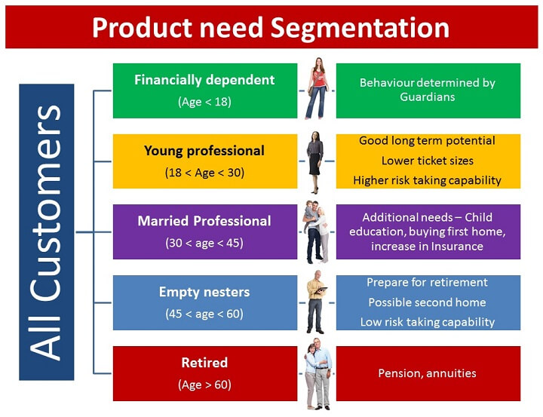
Why Customer Segmentation?
We needed a new way to understand our customers in a structured manner”

Slide 3
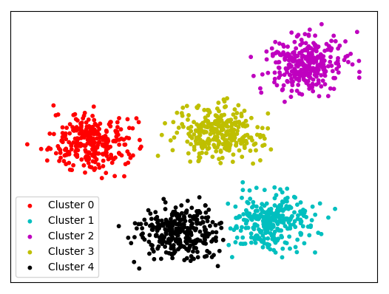
Introduction to Clustering
Clustering can be considered the most important unsupervised learning problem. So, as every other problem of this kind, it deals with finding a structure in a collection of unlabelled data. A loose definition of clustering could be “the process of organizing objects into groups whose members are similar in some way”.
A cluster is therefore a collection of objects which are “similar” between them and are “dissimilar” to the objects belonging to other clusters.

Slide 4
content
● Problem Statement
● Data Summary
● EDA / Feature analysis
● Data preparation
● Create RFM model
● Implementing various clustering Models
● Challenges
● Conclusion

Slide 5
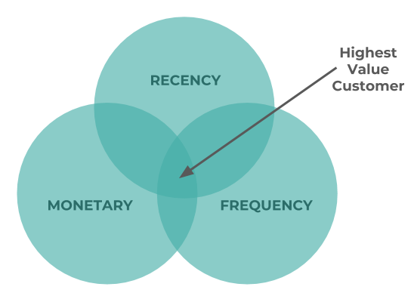
Problem statement
● This project aims to identify major customer segments on a transnational data set for a UK-based online retail.
● Create RFM table
● We need to analyse and identify major customer segmentation using k means algorithm and also different algorithms to confirm our result.

Slide 6



Slide 7
Data Summary
• InvoiceNo: Invoice number. Nominal, a 6-digit integral number uniquely assigned to each transaction..
• StockCode: Product (item) code. 5-digit integral number uniquely assigned to each distinct product.
• Description: Product (item) name.
• Quantity: The quantities of each product (item) per transaction.
• InvoiceDate: Invoice Date and time. The day and time when each transaction was generated
. • UnitPrice: Unit price. Product price per unit in sterling
. • CustomerID: Customer number.
• Country: Country name. Nominal, the name of the country where each customer resides.

Slide 8
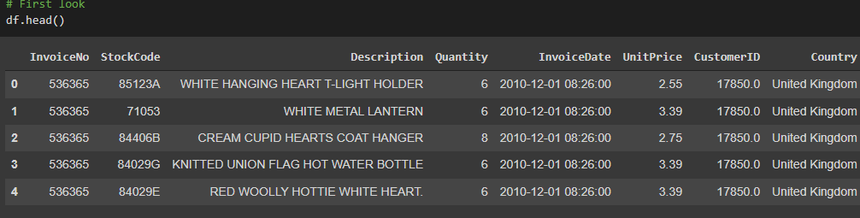
Basic Data Exploration
● A transnational data set with transactions occurring between 1st December 2010 and 9th December 2011 for a UK-based online retailer
. ● Dataset has rows- 541909 & columns-8
. ● The company mainly sells unique all-occasion gifts. ● Many customers of the company are wholesalers

Slide 9
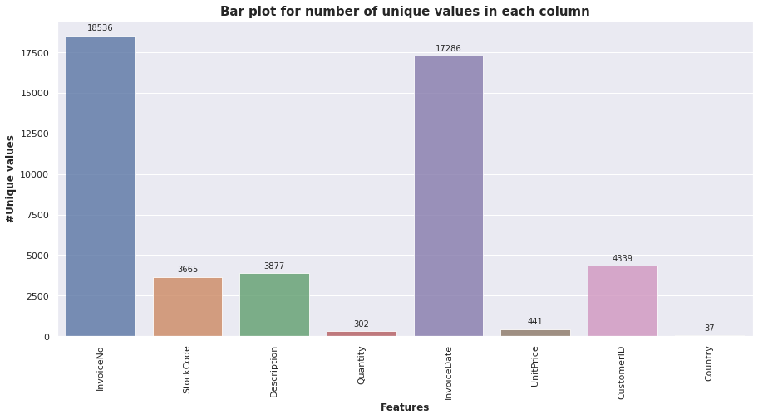
EDA - Which feature has the highest number of unique values?
The invoice number is unique for every transaction. Invoice Date has second highest count

Slide 10
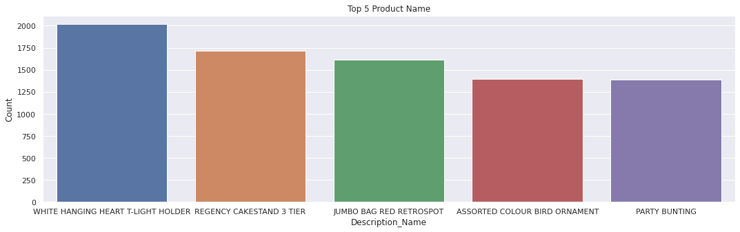
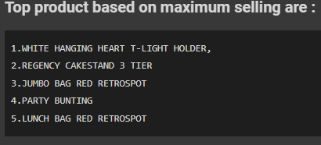
EDA – Finding Top product based on maximum selling
White Hanging Heart T- Light Holder is the top product.

Slide 11
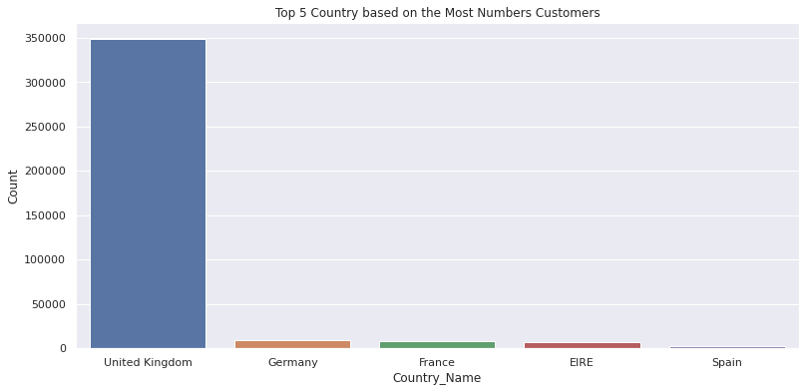
EDA - Top 5 Country based on the Most Numbers Customers?
In This graph, we can observe that most purchases are from the United Kingdom. It is justifiable also, as this is UK’s company.

Slide 12
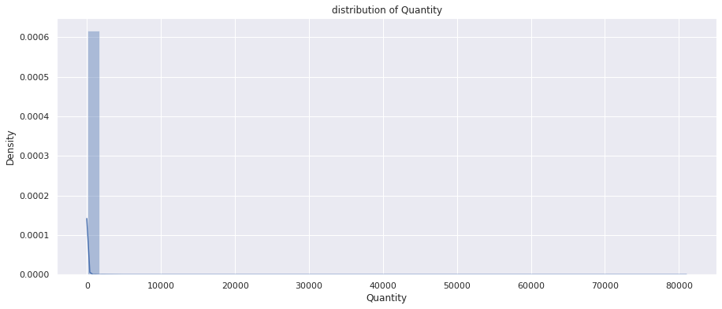
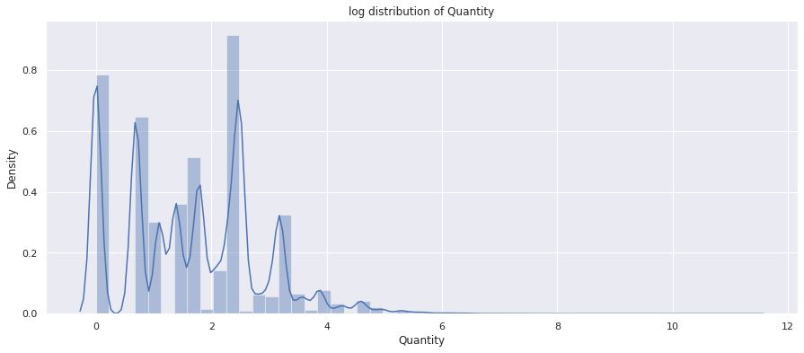
Log transformation of quantity
For better accuracy, applied log distribution on quantity.

Slide 13
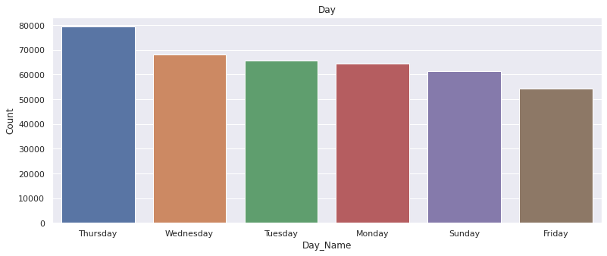
EDA- which day has highest count?
Most of the customers have purchased items on Thursday, Wednesday, Tuesday.

Slide 14
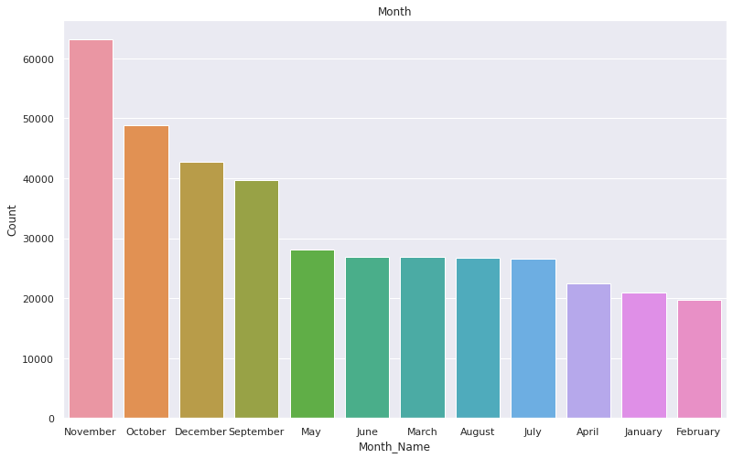
Which month has the highest count ?
Most of the customers have purchased items in November, October, December, and the least number of purchases in April, January, February.

Slide 15
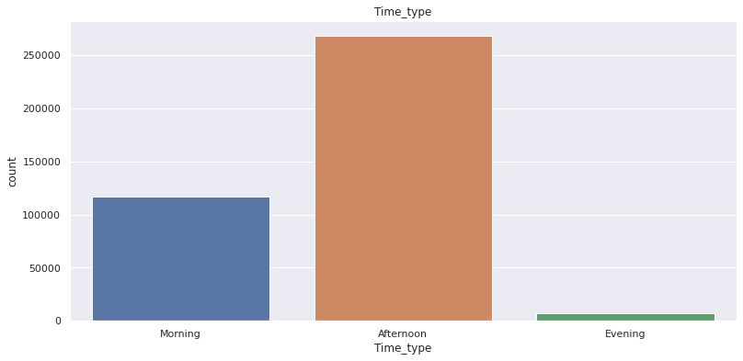
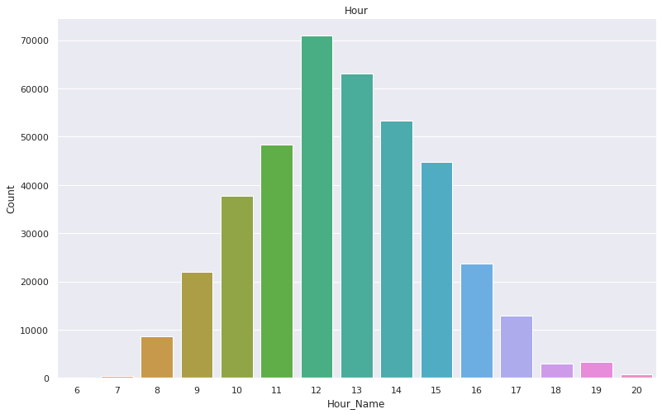
Hour wise Analysis
Most of the customers purchase in the afternoon time. The 12th hour of the day is a peak for purchasing items. Moderate numbers of customers have purchased the items in the Morning and the least numbers of customers have purchased the items in the Evening.

Slide 16
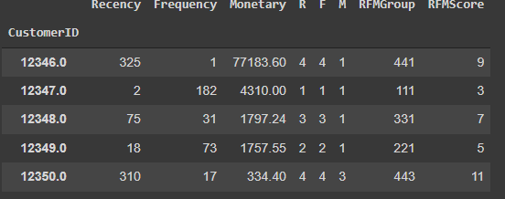
Create the RFM model (Recency, Frequency, Monetary value)

Slide 17
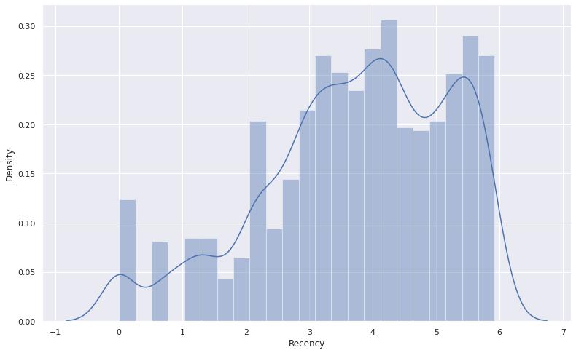
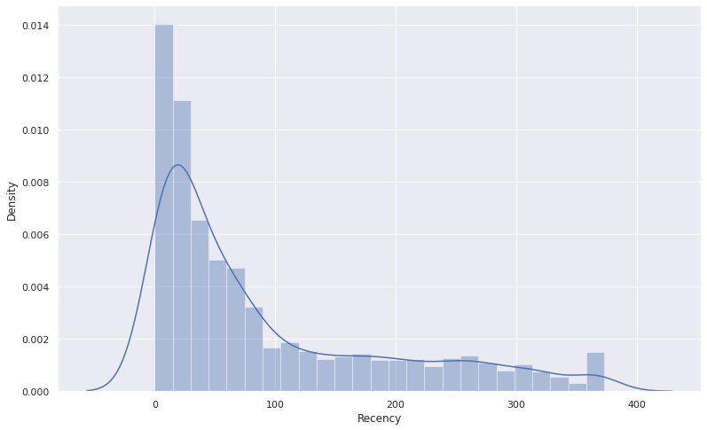
Log Transformation of Recency

Slide 18
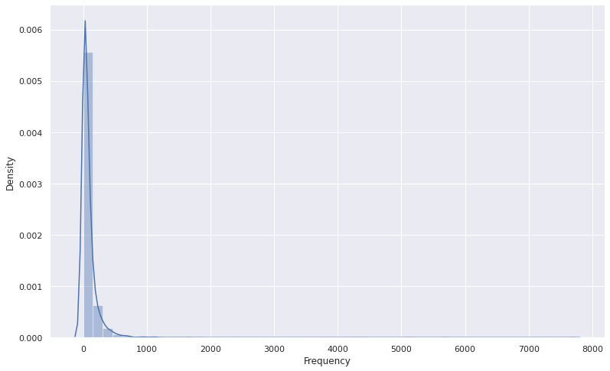
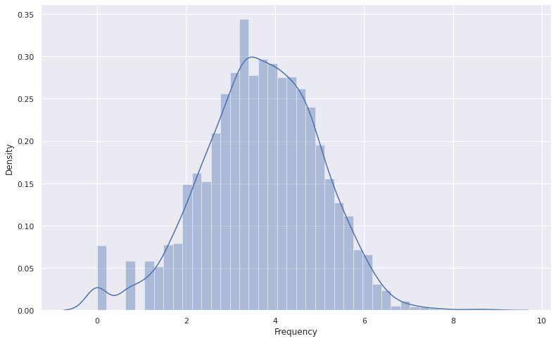
Log Transformation of Frequency

Slide 19
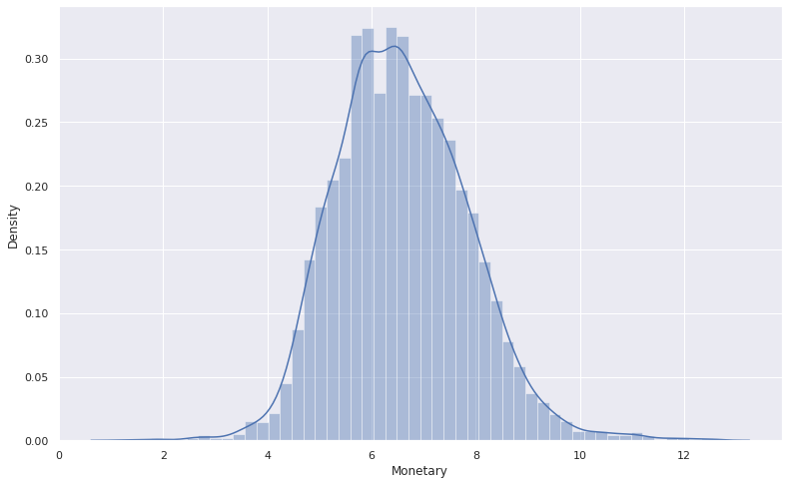
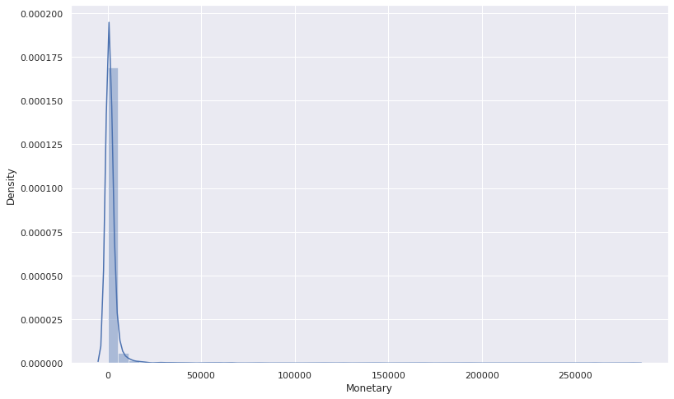
Log Transformation of Monetary

Slide 20
Model Overview
Let’s get some insight about Clustering models:
Silhouette score method : It is used to evaluate the quality of clusters created using clustering algorithms such as K-Means in terms of how well samples are clustered with other samples that are similar to each other. It ranges from -1 to1 , where a high value indicates that the object is well matched to its own cluster and poorly matched to neighbouring clusters.
Elbow method : a point from where the value of clusters starts decreasing suddenly, indicates the optimal number of clusters.
DBSCAN (Density Based Spatial Clustering of Application with Noise) : Finds core samples of high density and expands clusters from them.
Dendrogram : It is representation of hierarchical clustering.

Slide 21
Model Overview
❑ K-Means with silhouette score for RM
❑ K-Means with Elbow method FOR RM
❑ DBSCAN for RM
❑ K-Means with silhouette score for FM
❑ K-Means with Elbow method for FM
❑ DBSCAN for FM
❑ K-Means with silhouette score for RFM
❑ K-Means with Elbow method for RFM
❑ Hierarchical clustering for RFM
❑ DBSCAN for RFM

Slide 22
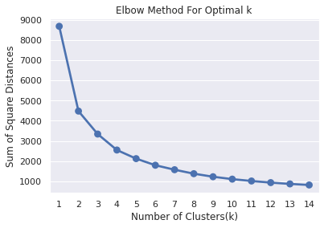
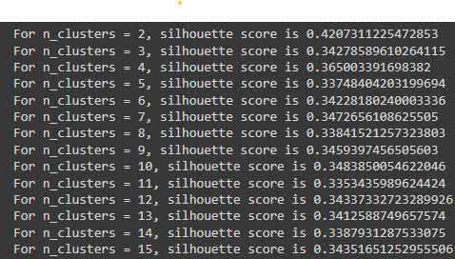
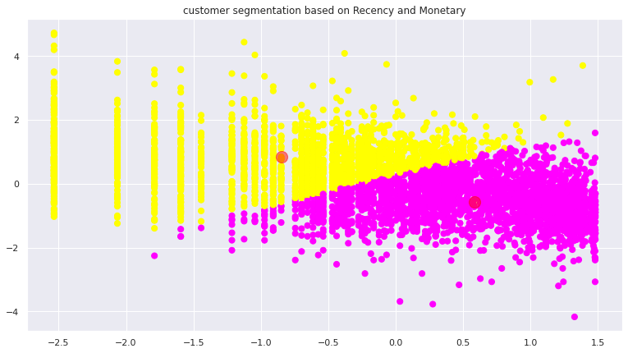
Applying Silhouette Score and Elbow Method on Recency and Monetary
We can see that, Customers are well separated when we cluster them by Recency and Monetary.

Slide 23
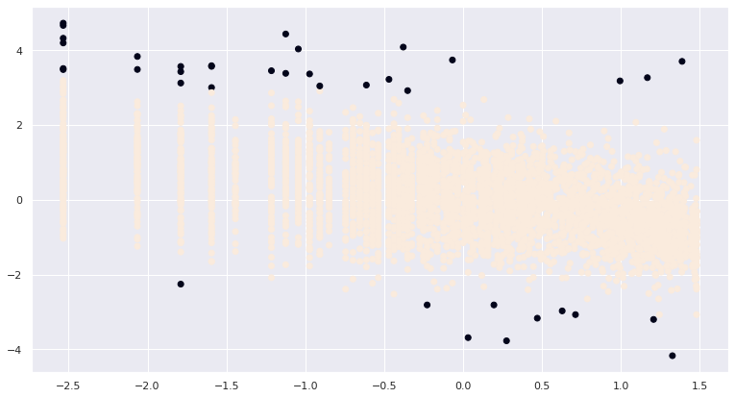
Applying DBSCAN on Recency and Monetary
From above plot, we can observe that Customers are well separate when we cluster them by Recency and Monetary. We got 2 as optimal number of clusters.

Slide 24
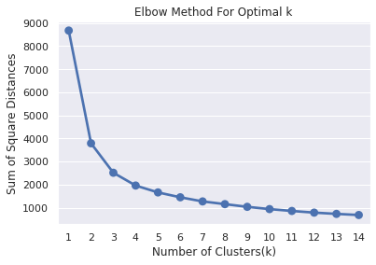
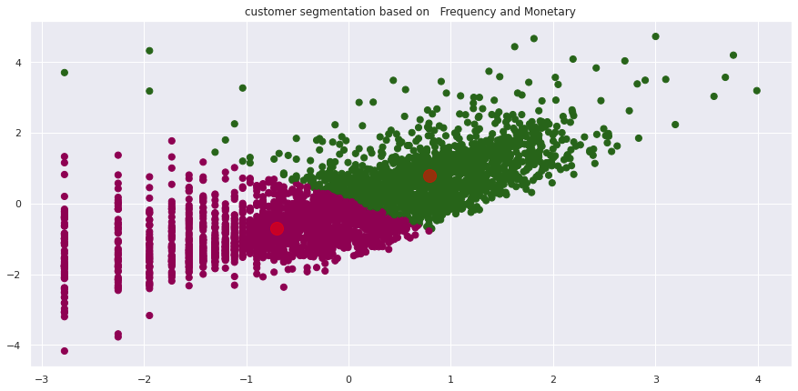
Applying silhouette Score and Elbow Method on Frequency and Monetary
From this plot, We found Customers are well separated when we cluster them by Frequency and Monetary

Slide 25
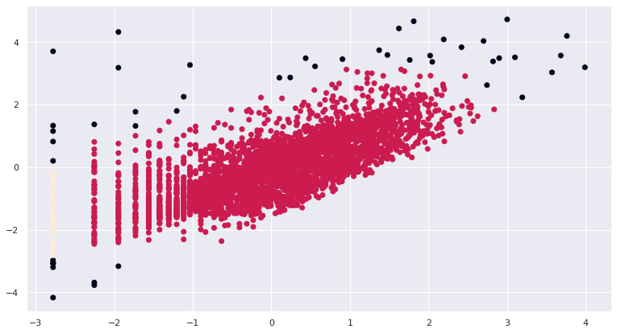
Applying DBSCAN on Frequency and Monetary
We can see that Customers are well separated when we cluster them by Frequency and Monetary. We got 2 as optimal number of clusters

Slide 26
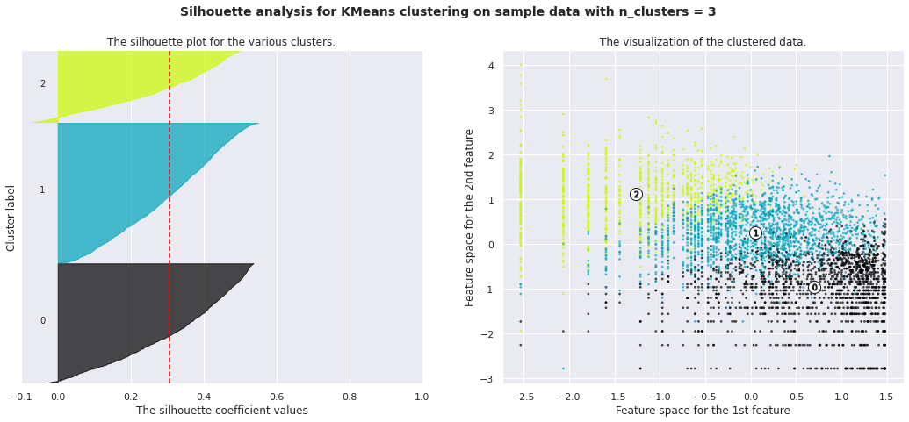
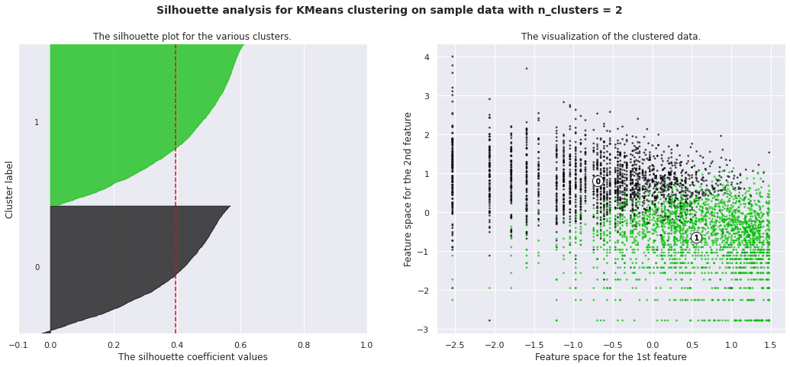
Applying Silhouette Method on Recency, Frequency and Monetary

Slide 27
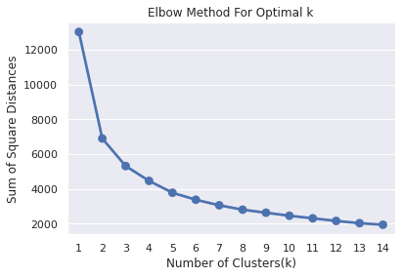
Applying Elbow Method on Recency, Frequency and Monetary
This method also gives information about the optimal number of clusters. According to it, 2 is the optimal number of clusters.

Slide 28
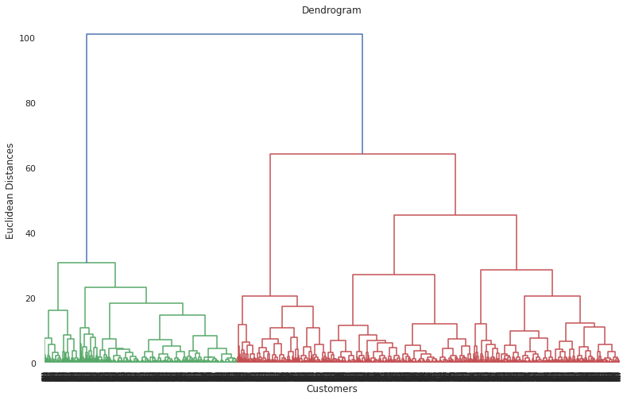
Using the Dendrogram to find the optimal number of clusters
The number of clusters will be the number of vertical lines which are being intersected by the line drawn using the threshold=90. No. of Cluster = 2

Slide 29
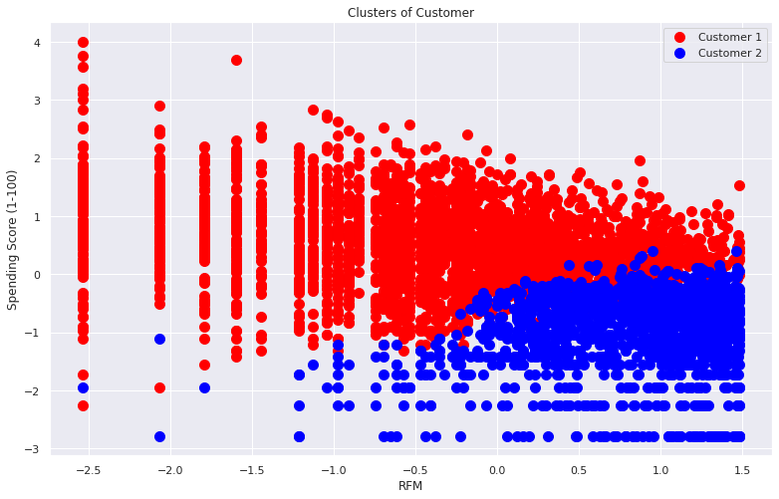
Visualizing the clusters (two dimensions only)

Slide 30
Challenges
● Understanding the problem statement
. ● Figuring Out right Approach
● Dealing with Null And duplicate values
● Treatment of cancelled orders
● Extracting Datetime Column Properly and creating RFM variables.
● Designing multiple visualizations to summarize the Data points in the dataset and effectively communicating the results and insights to the reader
. ● Finding optimal number of clusters

Slide 31
Conclusion Descriptive Analytics
In conclusion, the data exploration of Online customer segmentation dataset shows
: ● Missing and duplicate values were found.
● Most of the purchases are from the United Kingdom. ● Most of the customers have purchased items on Thursday, Wednesday, Tuesday
. ● Most of the customers have purchased items in November, October, December, and the least number of purchases in April, January, February
. ● Most of the customers purchase in the afternoon time. The 12th hour of the day is a peak for purchasing items.

Slide 32
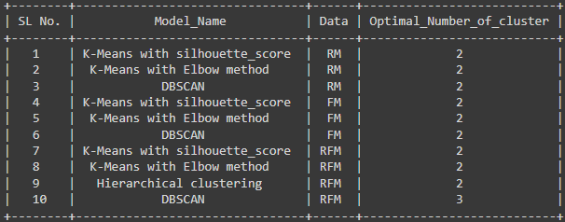
Conclusion
By applying different clustering algorithm to our dataset, we get the optimal number of cluster is equal to 2.

Slide 33
Final Thought
Customer segmentation is an important marketing approach that businesses should employ in order to gain a better understanding of the market and make more informed decisions in order to increase
sales. K-Means clustering is a basic but effective machine learning algorithm that businesses can use. Finally, in order to optimise our marketing success, we must keep the RFM client segmentation up to date

Slide 34
Further analysis
● New variables have been added, such as tenure, which is the number of days since each customer's first transaction. This will reveal how long each customer has been a member of the system.
● Customers are being segmented more deeply based on their physical location, as well as demographic and psychographic factors.
● Incorporating data from the company's Google Analytics account. Google Analytics is an excellent tool for tracking a variety of essential business data, including Customer Lifetime Value, Traffic Source/Medium, Pageviews per Visit, and Bounce Rate of a company's website, among others.

Slide 35
Thank you

